Slide 1
Microsoft Power BI

Slide 2
Building Multi-language Reports in Power BI
Ted Pattison
Principal Program Manager
Power BI Customer Advisory Team (PBICAT)

Slide 3
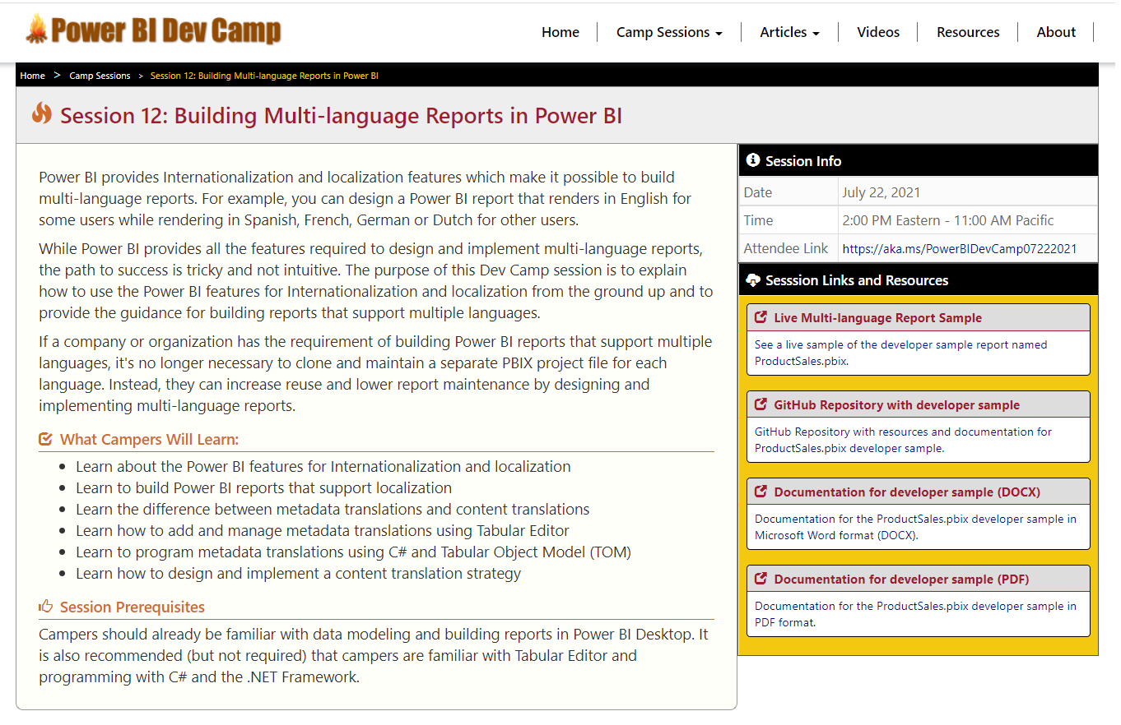
Welcome to Power BI Dev Camp
Power BI Dev Camp Portal - https://powerbidevcamp.net

Slide 4
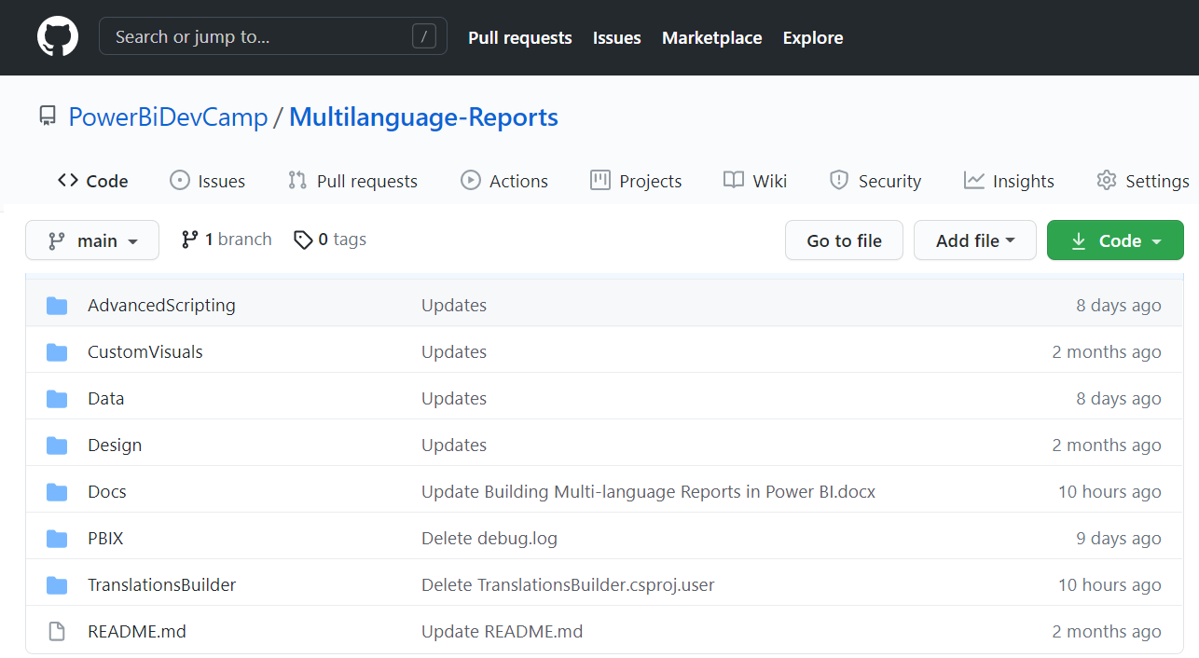
GitHub Repository with Developer Sample Code
All source code and documentation available through public GitHub repository
https://github.com/PowerBiDevCamp/Multilanguage-Reports

Slide 5
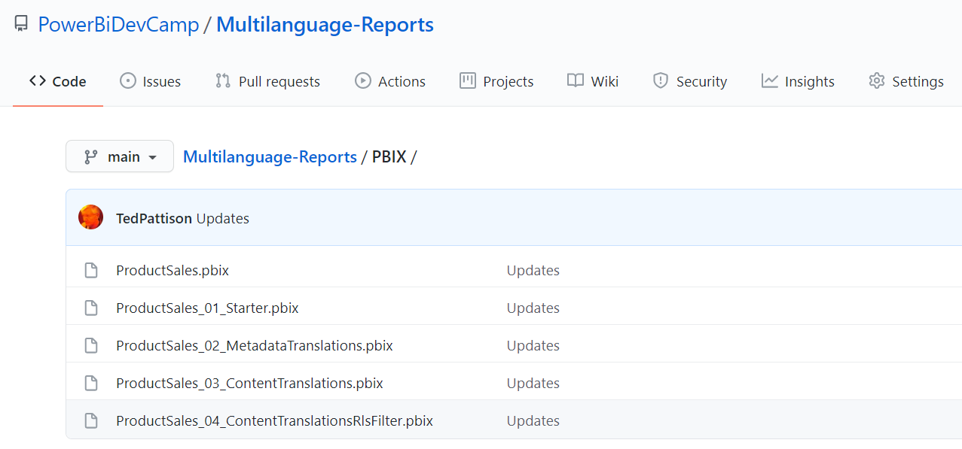
PBIX Folder Contains Samples Project Files
You can see a sample of the PBIX project file at each stages of development

Slide 6
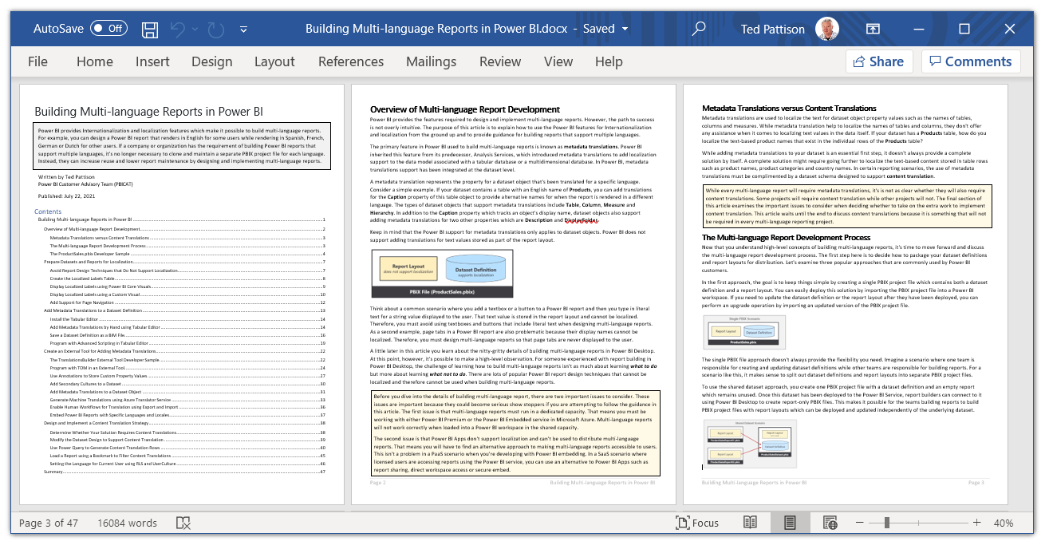
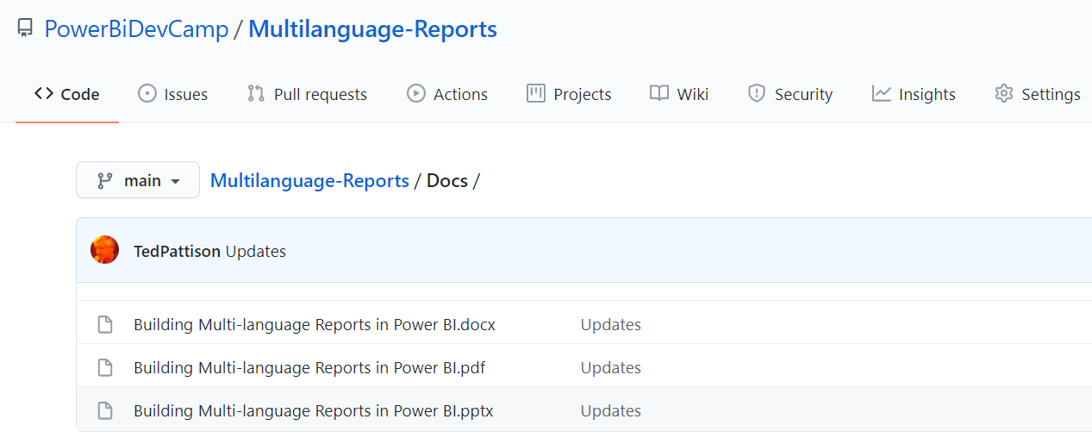
Guidance Documentation
Guidance document provides wealth of low-level developer details
DOCX
PDF

Slide 7
Agenda
Overview of Multi-language Report Development
Prepare Datasets and Reports for Localization
Add Metadata Translations to a Dataset Definition
Create an External Tool for Adding Metadata Translations
Design and Implement a Content Translation Strategy

Slide 8
Building Multi-language Reports in Power BI
Power BI provides Internationalization and localization features
They make it possible to build multi-language reports
You can design report that render in English, Spanish, French, German or Dutch
It's no longer necessary to copy/maintain a separate PBIX file per language
Building multi-language reports will decrease maintenance and overhead
Important considerations for multi-language report development
Building multi-language reports is tricky and non-intuitive
The deployment of multi-language reports/datasets requires Power BI Premium
Power BI Apps do not support localization – you must deploy reports some other way

Slide 9
Challenges in Building Multi-language Reports in Power BI
Building multi-language reports is tricky and non-intuitive
Some parts of Power BI are designed to support localization, others are not
Adding localization support requires advanced tooling and/or custom code
Some aspects of building multi-language reports require developer-level knowledge
How does the Power BI report development process change?
Report authors must avoid features & techniques that do not support localization
Learning What Not To Do is more important than learning What To Do
Many existing Power BI reports will require redesign from ground up

Slide 10
Metadata Translations
Localization in Power BI only supported at level of dataset definition
Report layout provides no support for localization
Metadata translations supported for the localization of dataset object properties
Dataset object types supporting localization include Table, Column, Measure and Hierarchy
Dataset object translation properties include Caption, Description and DisplayFolder
Report labels can be localized with metadata translations using specialized approach
Metadata translations cannot be used to localize row-based content (e.g. product names)
Metadata translations currently require Power BI Premium – not supported in shared capacity
Report Layout does not support localization
Dataset Definition
supports localization
PBIX File (ProductSales.pbix)

Slide 11
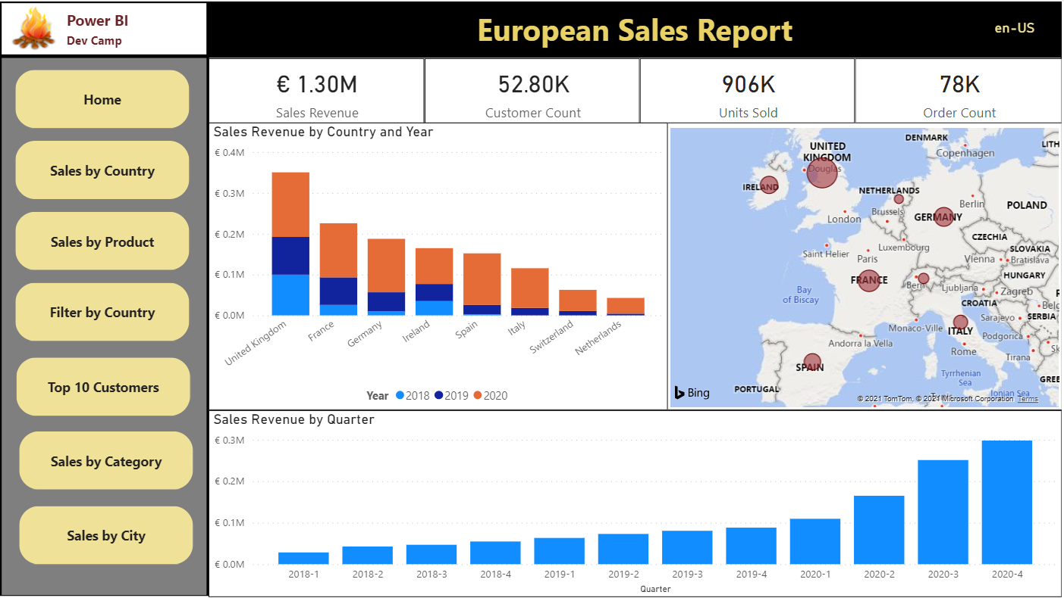
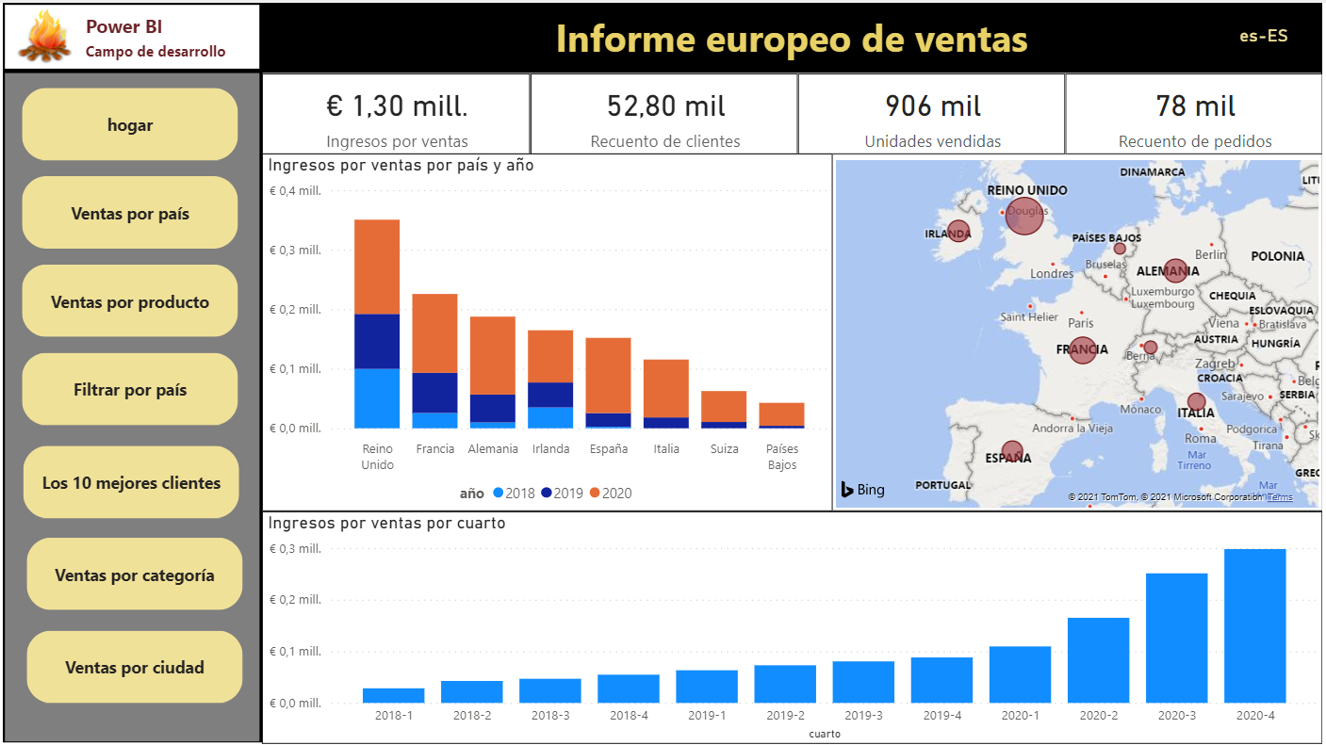
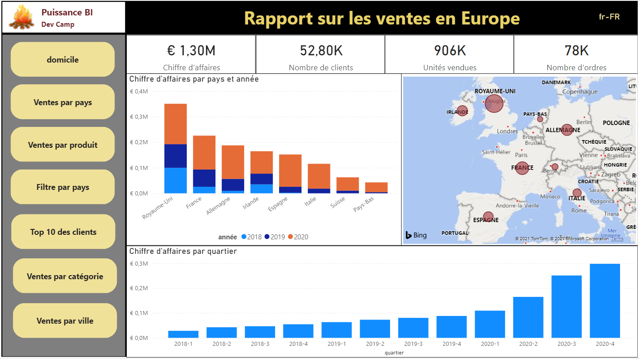
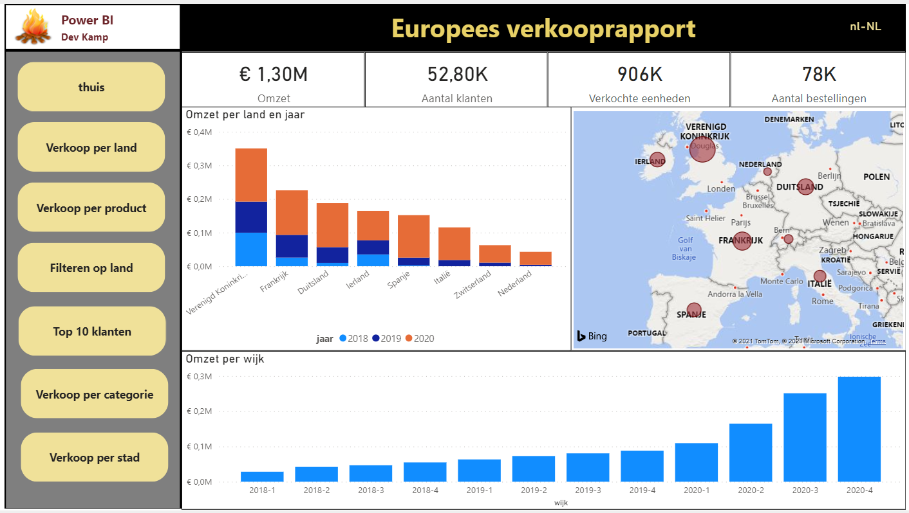

Product Sales Demo
Live demo at https://multilanguagereportdemo.azurewebsites.net/
English
Spanish
French
German
Dutch

Slide 12
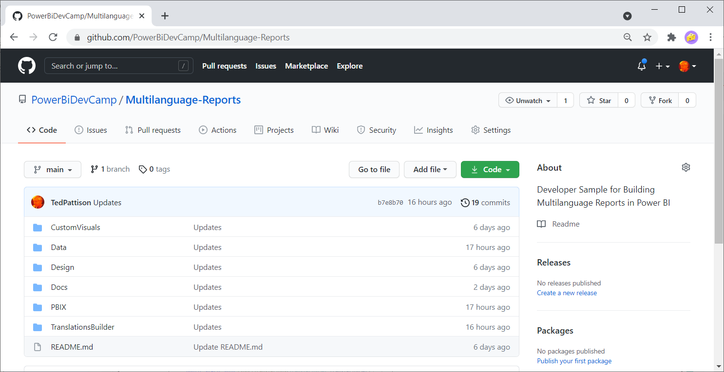
GitHub Repository for Multilanguage-Reports Sample
All sample code for this developer samples available for download
https://github.com/PowerBiDevCamp/Multilanguage-Reports

Slide 13
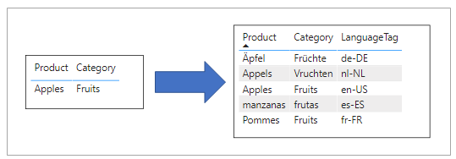
Understanding Content Translation
Metadata translations cannot be used to localize row-based content
Metadata translations cannot localize actual data in dataset (e.g. product names)
Multi-language report might (or might not) require support for content translation
You can add support for content translations using industry-adopted database design patterns
Best practices for Power BI solutions currently based on replicated rows pattern

Slide 14
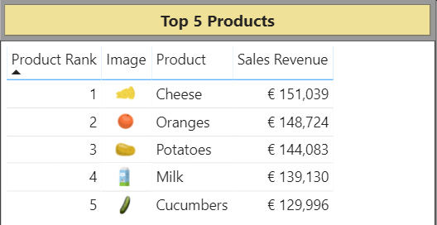
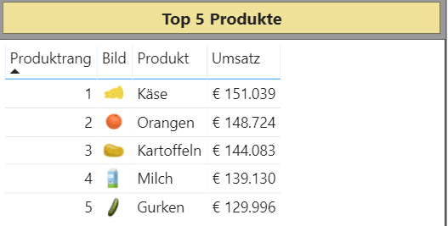
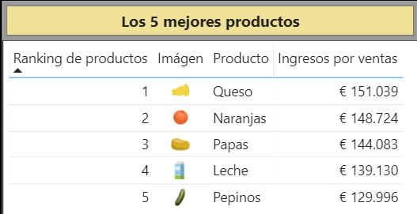
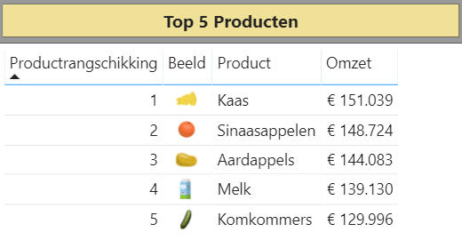
Metadata Translations Combined with Content Translations

Slide 15
Workflow for Multi-language Report Development Process
Prepare datasets and reports to support localization
Design data model for dataset with tables, columns, measure and hierarchies
Create Localized Labels table and add measures to support localizing report labels
When designing reports - avoiding design techniques that don’t support localization
Add metadata translations to dataset
Add metadata translations to dataset project using external tool support
Requires using Tabular Editor or programming Tabular Object Model (TOM)
Design and implement content translation strategy (if required)
Content translation design based replicated rows pattern
Can be implemented using Power Query and translation lookup tables

Slide 16
Agenda
Overview of Multi-language Report Development
Prepare Datasets and Reports for Localization
Add Metadata Translations to a Dataset Definition
Create an External Tool for Adding Metadata Translations
Design and Implement a Content Translation Strategy

Slide 17
How to Package Reports and Datasets for Distribution
Use simplest approach based on single PBIX file
Use a shared dataset approach with multiple PBIX files
Use advanced tools to create and maintain dataset definition in .BIM file format
Guidance for localizing Power BI datasets and reports will be the same in all cases
Single PBIX Scenario
Shared Dataset Scenario
Advanced Data Modeling Scenario
Report Layout
Report Layout
Report Layout
(not used)
Report Layout
Dataset Definition
ProductSalesReport01.pbix
Dataset Definition
ProductSalesReport01.pbix
Dataset Definition
ProductSales.pbix
Report Layout
ProductSalesDataset.pbix
Report Layout
productsales.model.bim
ProductSalesReport02.pbix
ProductSalesReport02.pbix

Slide 18
Preparing a Power BI Report for Localization
Plan localization from the start
Much harder to work with pre-existing PBIX created without localization in mind
Plan for content growth
Some languages have content wider than English
Include padding for translated content
Avoid report design techniques that do not support localization
Don’t add literal text in visuals, textboxes or buttons
Don’t display page tabs - their display names cannot be localized

Slide 19
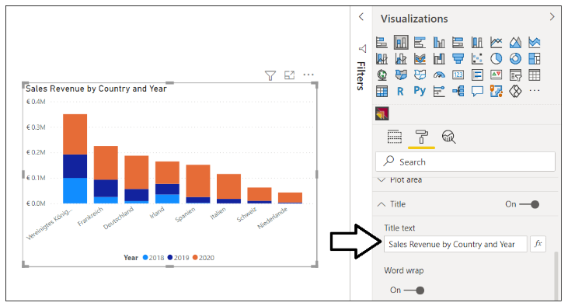
Using Dynamic Visual Titles
Dynamic visual titles will use translations for column and measure names
They are automatically translated when using dataset translations
Do not set visual title using literal text
Language | Visual Title
English | Sales Revenue by Country and Year
Spanish | Ingresos por ventas por país y año
French | Chiffre d’affaires par pays et année
German | Umsatz nach Land und Jahr
Dutch | Omzet per land en jaar

Slide 20
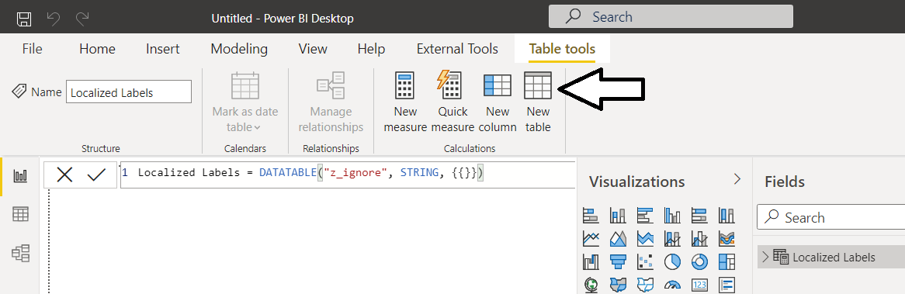
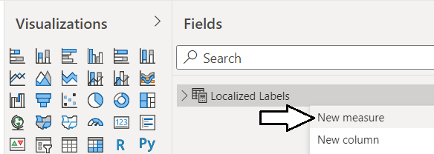
Creating the Localized Label Table
Localized Label table provides strategy for localizing report labels
Report labels required for titles, headers and button captions
Report labels requiring localization should be created as measures
Localized labels leverage Power BI support for localizing measure names
How to get started?
Create the Localized Label table
Add a new measure for each string-based report label that requires localization

Slide 21
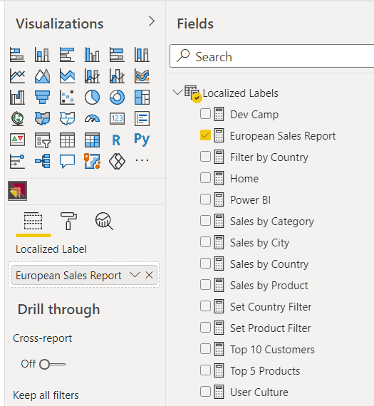
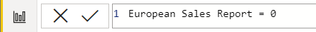
Adding Measures to the Localized Labels Table
Create a new table in data model named Localized Labels
Add a measure for any string content that needs to be localized
Set measure expressions to 0

Slide 22
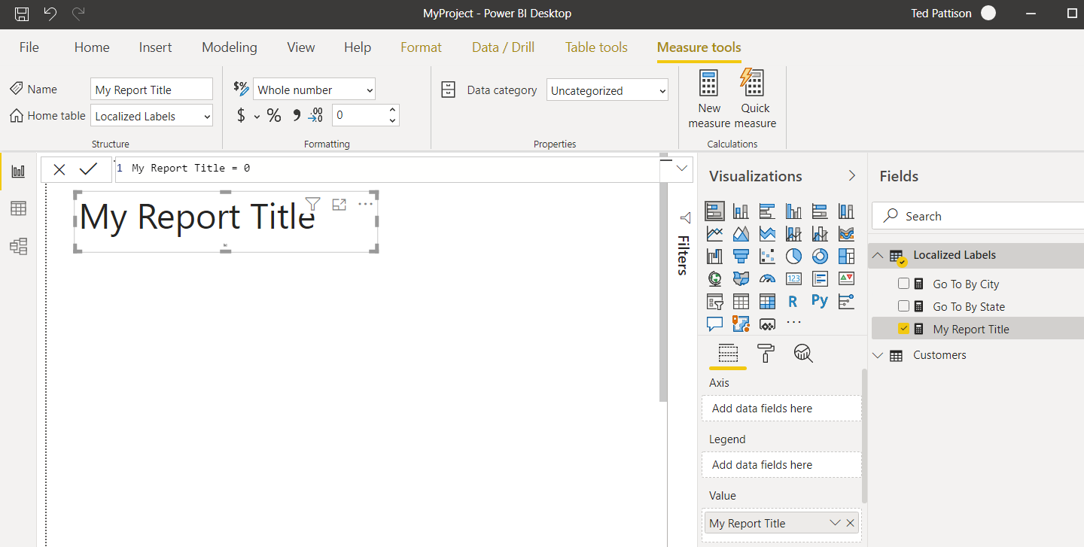
Surfacing a Localized Label
You can surface localized label using one of core Power BI visuals
Add Stacked Barchart visual and add localized label in Values data roles

Slide 23
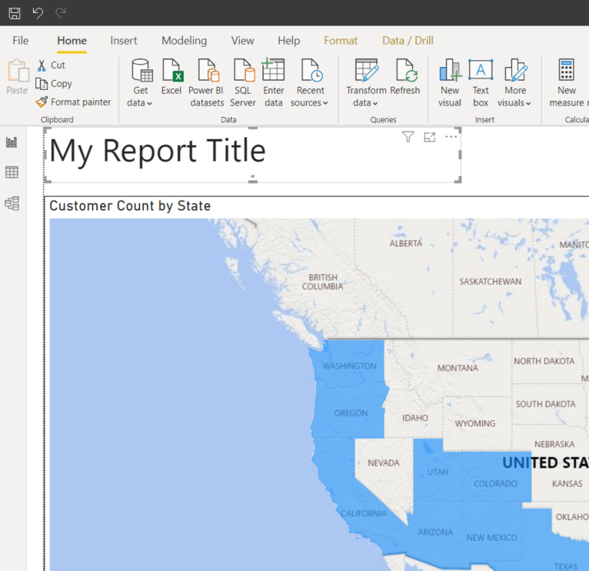
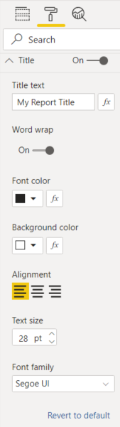
Configuring Localized Label Display Properties
You can use the Format pane to configure label display properties
Design experience for this technique is limited

Slide 24
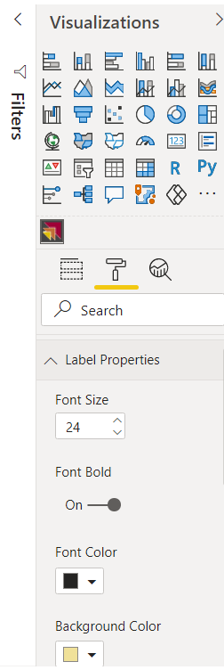
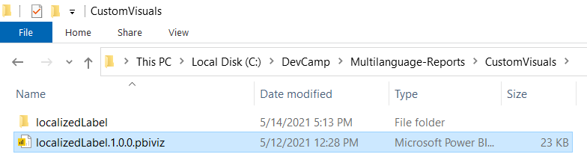
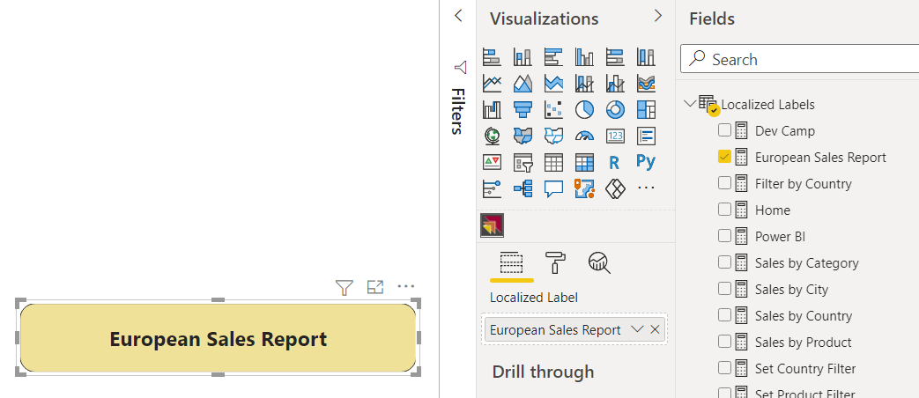
Developing a Custom Visual: LocalizedLabel
You can develop a custom visual to surface localized labels
Developer sample GitHub repository provides custom visual project
Provides more flexibility in configuring display properties

Slide 25
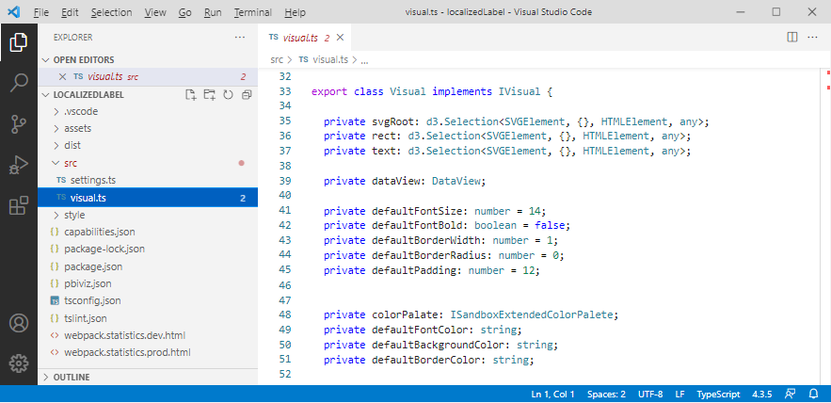
Examining the localizedLabel Custom Visual Project
Source code for localizedLabel project available in GitHub repository
Developers can use it as a starting point for create their own custom visual

Slide 26
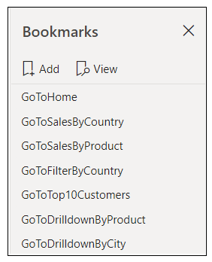
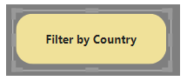
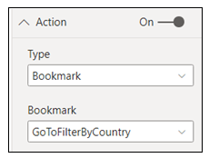
Designing Navigation
Page tabs do not support localization – they should be hidden from user
Page-to-page navigation can be designed with shapes and bookmarks
Shape should be configured as transparent and with action to apply bookmark
Shape
Localized Label

Slide 27
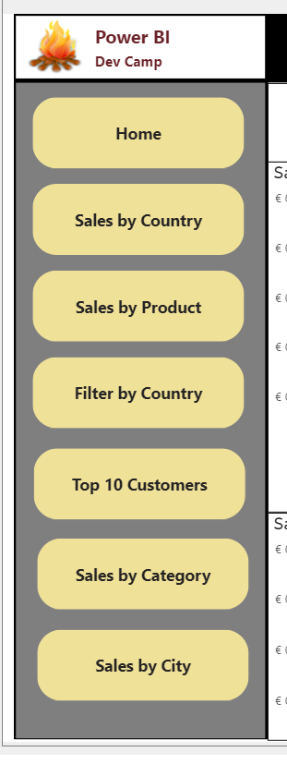
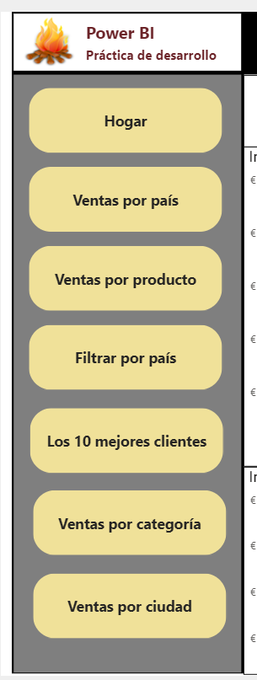
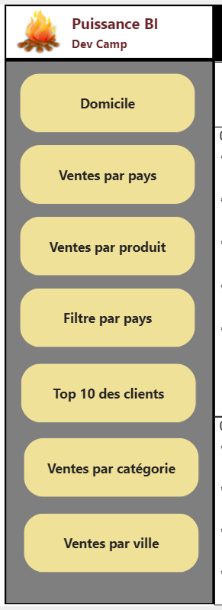
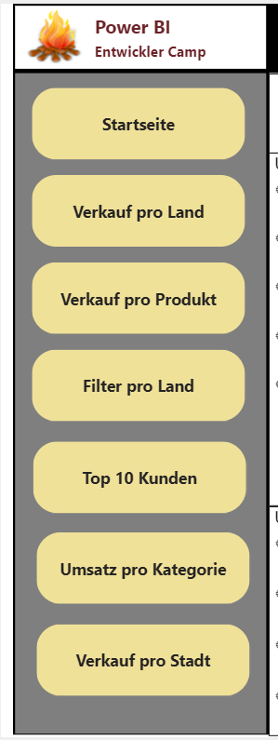
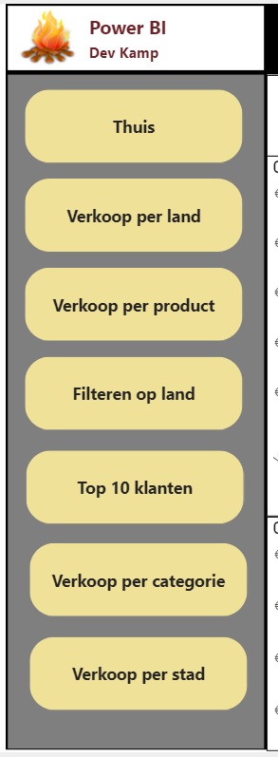
Translating Button Captions
English (en-US)
Spanish (es-ES)
French (fr-FR)
German (de-DE)
Dutch (nl-NL)

Slide 28
Agenda
Overview of Multi-language Report Development
Prepare Datasets and Reports for Localization
Add Metadata Translations to a Dataset Definition
Create an External Tool for Adding Metadata Translations
Design and Implement a Content Translation Strategy

Slide 29
Adding Metadata Translations
You can add dataset translations into PBIX project file
You can add/manage dataset translations on datasets running in Power BI Service
Tabular
Editor
Power BI Desktop
PBIX Project File
Dataset
Custom Code using TOM
Tabular
Editor
Power BI Service
Premium Workspace
XMLA
Endpoint
Dataset
Custom Code using TOM

Slide 30
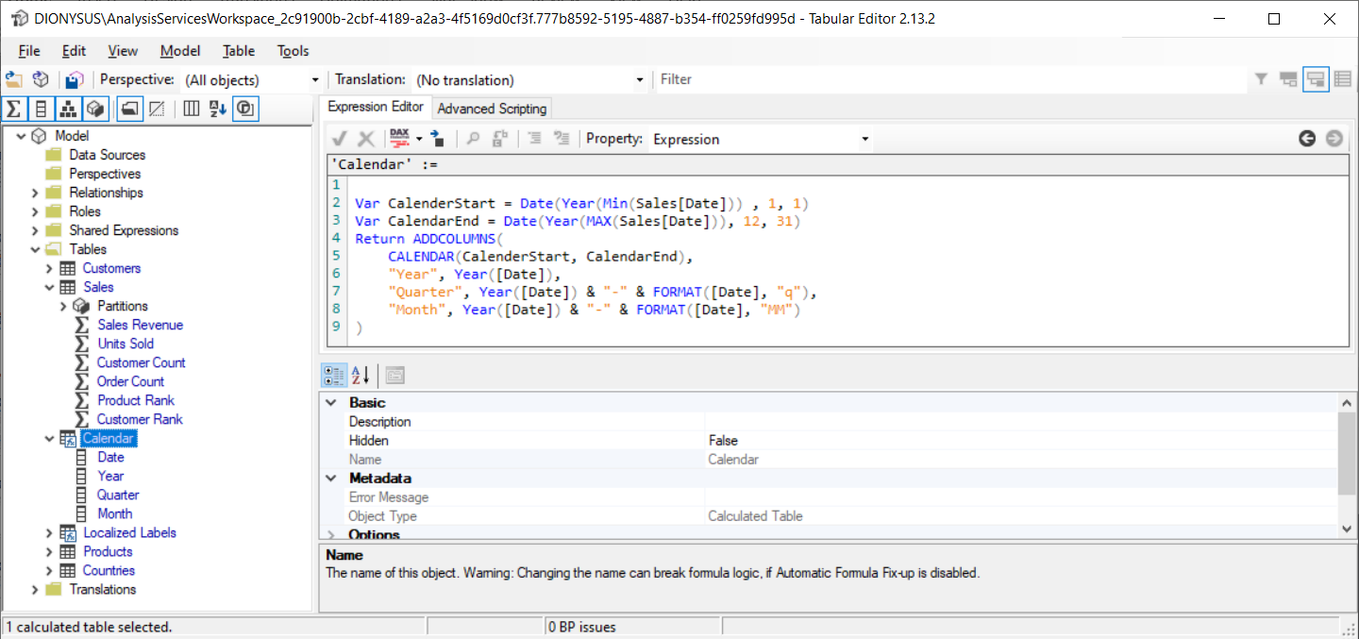
Working with Tabular Editor
Tabular Editor is external tool integrated with Power BI Desktop
Download from https://github.com/otykier/TabularEditor/
Provides control over advanced data modeling features
Provides Advanced Scripting features to automate development tasks

Slide 31
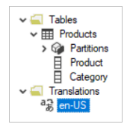
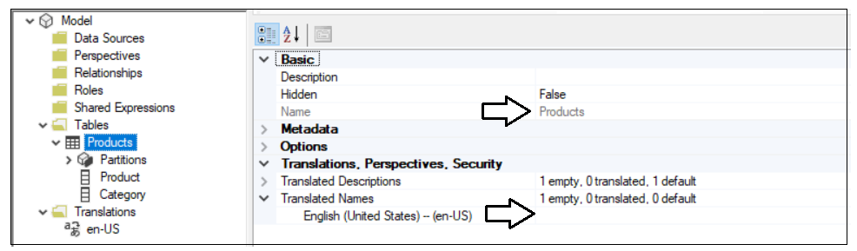
Understanding Cultures
Every dataset has a collection of one or more Culture objects
Each culture object based on a specific language and a specific user locale
Each new dataset is created with a single culture – this is the default culture
ProductSales.pbix has default culture of en-US for English in the United States
Every metadata translation must be added within scope of a culture

Slide 32
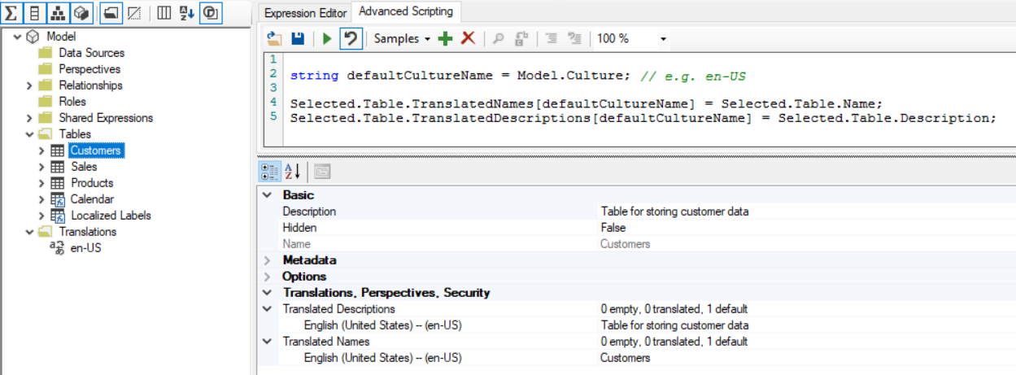
Populating Translations in the Default Culture
You start by adding metadata translations to the default culture
In a new dataset, default culture contains no metadata translations
You can add metadata translations by hand or by using Advanced Scripting

Slide 33
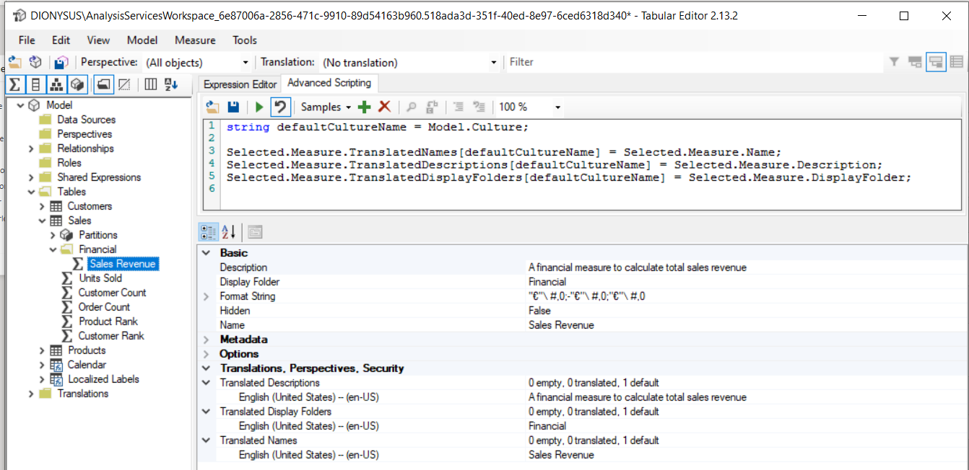
Adding Metadata Translations using Tabular Editor
Tabular Editor provides collection properties to add translations
Translated Names: used to add metadata translations for dataset object names
Translated Descriptions: used to add metadata translations for dataset object descriptions
Translated Display Folders: used to add translations for dataset object display folder names

Slide 34
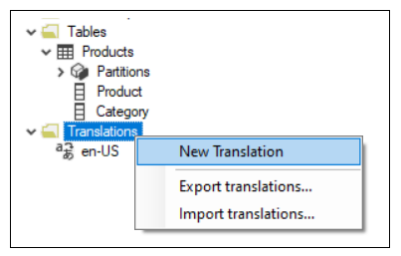
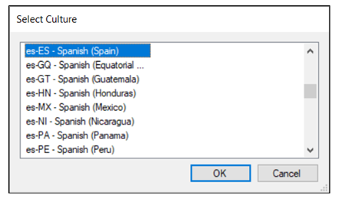
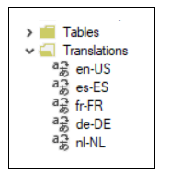
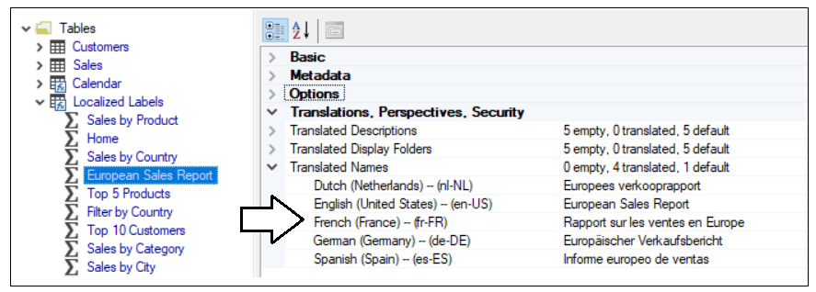
Adding Secondary Cultures
Adding secondary cultures to a dataset
Use New Translation command and choose culture from Select Culture dialog
Once secondary cultures have been added, add metadata translations for secondary cultures

Slide 35
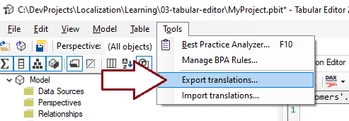
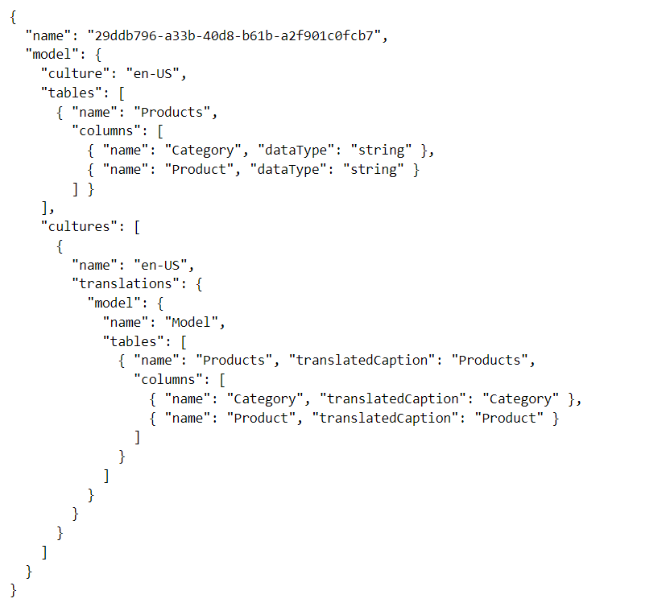
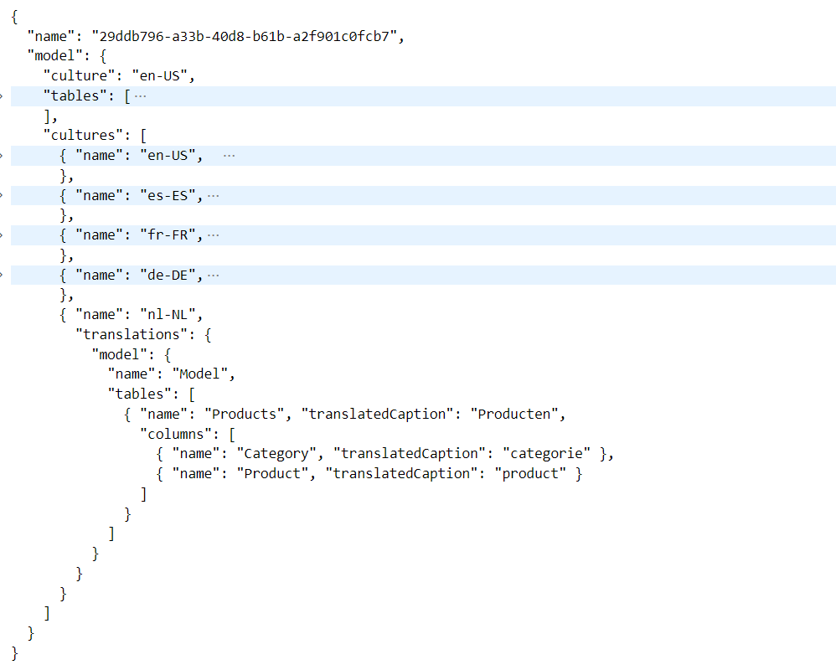
Exporting/Importing Metadata Translations
Tabular Editor supports exporting/importing translations
Export metadata after populating translations for default language
Design workflow with human translators to add translations
Import updated translation back into PBIX project using Tabular Editor

Slide 36
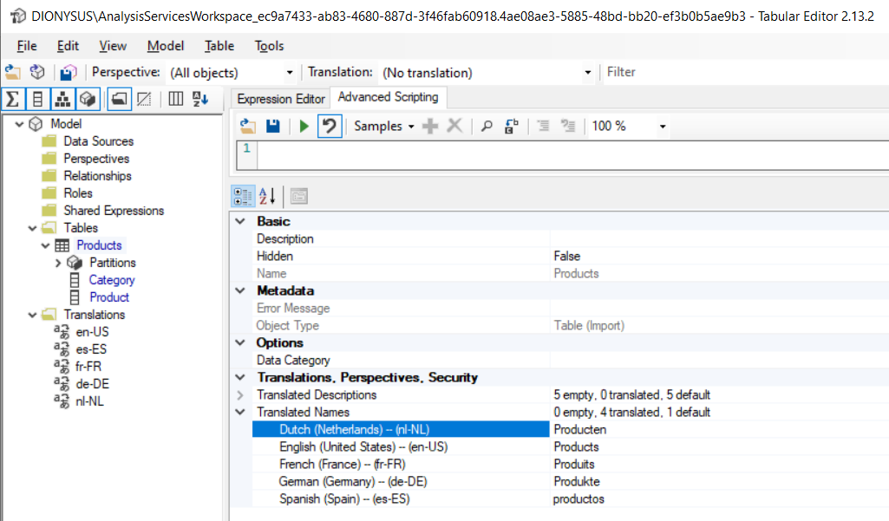
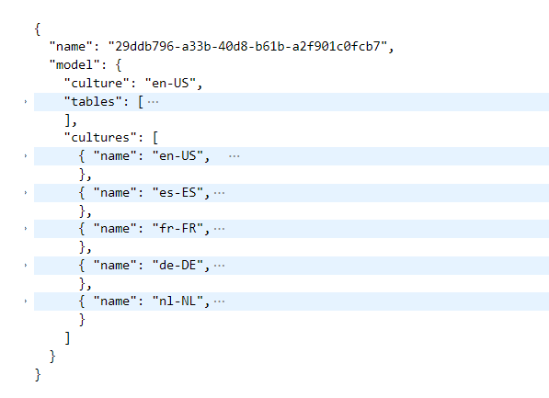
Importing Translations using Tabular Editor
Tabular Editor provides Import Translations command
Makes it possible to automate to populating metadata translations
Back from translators
Import

Slide 37
Agenda
Overview of Multi-language Report Development
Prepare Datasets and Reports for Localization
Add Metadata Translations to a Dataset Definition
Create an External Tool for Adding Metadata Translations
Design and Implement a Content Translation Strategy

Slide 38
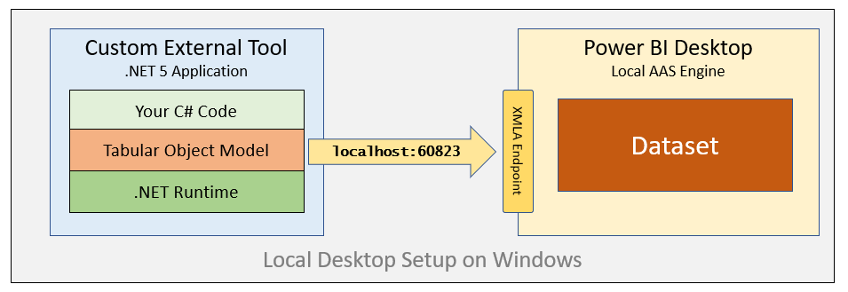
Developing an External Tool for Power BI Desktop
Power BI Desktop provides support for integrating external tools
External tool can be launched from Power BI Desktop
External tool can connect to dataset inside a PBIX project file
External tool can be designed to add and manage metadata translations
External tool must be programmed to use Tabular Object Model (TOM)

Slide 39


External Tool Developer Sample: TranslationsBuilder
.NET application using C# which programs TOM to automate localization tasks
Provides code to populate translations of default culture
Provides code to add secondary cultures and populate their translations
Calls to Microsoft Translator Service to create starting set of translations for each language

Slide 40


Deploying an External Tool
Deployment requires creating JSON file with *.pbitool.json extension
Deployment file (translationsbuilder.pbitool.json) must be copied to this folder
C:\Program Files (x86)\Common Files\Microsoft Shared\Power BI Desktop\External Tools
After a restart, Power BI Desktop should display tile on External Tools tab of ribbon

Slide 41



Tabular Object Model (TOM)
TOM is extension of Analysis Management Object (AMO) client library
TOM supports programming against Power BI datasets using XMLA protocol
Power BI dataset represented in TOM with a Database object
Data model inside dataset represented in TOM with Model object
Model object provides access to dataset objects
TOM provides support for adding/managing metadata translations
Dataset object types supporting localization include Table, Column, Measure and Hierarchy
Dataset object translation properties include Caption, Description and DisplayFolder
Model object contains Culture property and Cultures collection

Slide 42

TranslationsManager class
TranslationsManager class contains logic to add cultures and add translations

Slide 43



Understanding Annotations
Annotations provide ability to store custom properties in dataset definition
Can be used to storing any type of custom metadata
Used in TranslationsBuilder to store friendly name for dataset
Annotation stored inside dataset definition

Slide 44

Programming Annotations

Slide 45



Adding Secondary Cultures
TranslationsBuilder allows user to add secondary cultures
Provides a list of available cultures to choose from
You can see which secondary cultures have already been added to a dataset

Slide 46

Adding Metadata Translations
When you create a new PBIX project…
It has a default culture (en-US) but that culture contains no metadata translations
You must add metadata translations for default culture
You must add secondary cultures and then add metadata translations to them
Model
Table
Column
Measure
Hierarchy
Cultures
Culture
Table
Column
Measure
Hierarchy

Slide 47


Slide 48

Populating the Default Culture with Metadata Translations
Populating default culture metadata translations is easy to automate using TOM

Slide 49


Generate Machine Translations using Azure Translator Service
You can use Azure Translator Service to generate machine translations
Azure Translator service can be called as Web API from external tool
Makes it possible to populate secondary language translations

Slide 50



Configure AppSettings for Azure Translator Service
You must create your own instance of Azure Translator Service
You must copy application key and location into Configuration Options dialog

Slide 51


This is the internal implementation in TranslatorService class which calls in Translator Service
This is the public method exposed to other code in the project

Slide 52


Slide 53



Enable Human Workflows for Translation using Export and Import
TranslationsBuilder support exporting translation sheets for human translators
Human translators can work in Excel with simple CSV file format
Updated translation sheets can be imported back into dataset definition

Slide 54

Loading Reports with Locale using a Query String Parameter
You can load report using specific locale
Add language query string parameter to report URL
Requires workspace in dedicated capacity
This technique will not change result for UserCulture function in DAX

Slide 55


Using localeSettings in Embed Config
You can load report using specific locale by adding localeSettings in embed config
This technique will change result for UserCulture function in DAX

Slide 56
Agenda
Overview of Multi-language Report Development
Prepare Datasets and Reports for Localization
Add Metadata Translations to a Dataset Definition
Create an External Tool for Adding Metadata Translations
Design and Implement a Content Translation Strategy

Slide 57
Content Translations Overview
All multi-language reports will require metadata translations
You cannot assume the same for content translations
Some projects will require content translations and others will not
Implementing content translations different from metadata translations
Power BI doesn't offer localization features to assist you with content translations
Implementation requires extending dataset with tables, columns and filters

Slide 58
Use Case #1 – Content Translations Not Required
Customer Deployment 1
User
English (en-US)
Metadata Translations without Content Translations
Azure SQL Server
Report Layout
Dataset Definition
Import
SQL Database
English (en-US)
User
English (en-US)
ProductSales.pbix
Customer Deployment 2
User
Spanish (es=ES)
Metadata Translations without Content Translations
Azure SQL Server
Report Layout
Dataset Definition
Import
SQL Database
Spanish (es-ES)
User
Spanish (es-ES)
ProductSales.pbix
Customer Deployment 3
User
German (de-DE)
Metadata Translations without Content Translations
Azure SQL Server
Report Layout
Dataset Definition
Import
SQL Database
German (de-DE)
User
German (de-DE)
ProductSales.pbix

Slide 59
Use Case #2 – Content Translations Required
When will you be required to implement content translations?
When people who speak different languages see the same database instance
Customer Deployment
User
English (en-US)
Metadata Translations with Content Translations
Azure SQL Server
User
Spanish (es=ES)
Dataset Definition
SQL Database
content translations
en | es | fr | de | nl
Report Layout
Import
ProductSales.pbix
User
German (de-DE)

Slide 60


Content Localization Through Row Replication
Power BI does not currently support dynamic column evaluation
When this support is added, it will drastically change the strategy
Until then, row replication is best way to localize content in addition to metadata
Row replication strategy involves adding separate rows for each language
Strategy implemented on dimension tables with text values requiring localization
Row filtering used to exclusively filter rows to one specific language
ETL with Content Translation

Slide 61
Content Localization in Power Query
You can use Power Query and import-mode dataset to implement content translations
This design approach eliminates the need to redesign the underlying database
Power BI Dataset
Azure SQL Database
ETL with Content Translation
Customer Deployment
User
English (en-US)
Metadata Translations with Content Translations
Azure SQL Server
User
Spanish (es=ES)
Report Layout
Dataset Definition
Import
SQL Database
English (en-US)
ProductSales.pbix
User
German (de-DE)

Slide 62

Using Power Query and M Code to Replicate Rows
Examine queries in ProductSales_03_ContentTranslations.pbix

Slide 63

Data Model Implementation of Row Replication Strategy
Row replication requires configuring many-to-many relationships
Many-to-many relationships can have significant impact on performance and scale
Row replication used for Products table
Customers table too big for row replication
Country names factored into Countries table to localize country named

Slide 64


Load Reports using Bookmarks to Filter Content Translations
Row replication pattern for content translation requires filtering
Filters must be added to Products table and Countries table
Best strategy involves creating a bookmark for each language to apply filtering

Slide 65

Loading Reports with Query String Parameters
Multi-language reports can be loaded using query string parameters
language parameter used to load the metadata translations for a specific language
bookmarkGuid used to apply bookmark to set content translation filtering

Slide 66


Loading Report with Replicated Row Strategy
App-Owns-Data developer can load report using Row-level Security roles
Create RLS role named LocaizedUser
Create RLS filter expressions to filter translated rows using UserCulture

Slide 67

Generating the Embed Token with LocalizedUser Role

Slide 68
Summary
Overview of Multi-language Report Development
Prepare Datasets and Reports for Localization
Add Metadata Translations to a Dataset Definition
Create an External Tool for Adding Metadata Translations
Design and Implement a Content Translation Strategy

Slide 69
Questions Microsoft Power BI

